Slide 1



Increasing the Impact of Consumer Voices
APSU- Association of Participating Service Users

Slide 2
APSU-The Association of Participating Service Users
The Association of Participating Service Users (APSU) is a Victorian consumer
representative body at the Self Help
Addiction Resource Centre (SHARC).
Why consumer voice is important

Slide 3

Ways that APSU Promotes Consumer Voice
*Provides access to consumers for organisations
*Strengthening consumer community through events etc.
*Training consumers to participate
*Various projects & media types which collate & spread consumer voices
*Advocating on behalf of consumers
*Lived experience organization

Slide 4
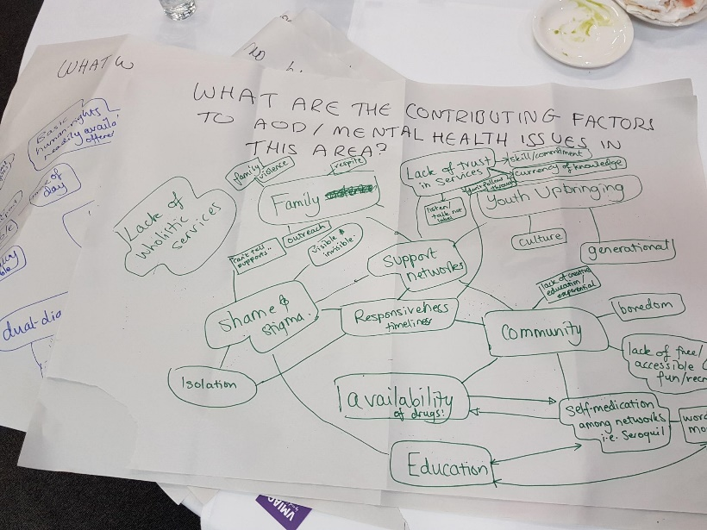
APSU & VMIAC Regional Roadshow Project
*In 2018, APSU and VMIAC
(Victorian Mental Illness Awareness Council)
held events in Ballarat, Bendigo, Traralgon,
Wangaratta and Wodonga.
*Gained information from AOD & MH consumers on
their experiences of services in local area
*They were asked:
What services they were familiar with;
What factors contribute to MH and AOD issues in their areas;
What were the issues with and barriers to, accessing services in their area
What changes they wanted to see in their ideal system.

Slide 5
Regional Roadshow Project Findings
Key findings:
Issues with representation
Stigma/ privacy/ confidentiality
Absence of services (peer, after-hours, flexible, population specific, preventative & long term services)
Access issues (wait times, cycles of referral & intake, disconnectedness)
Key suggestions:
Increase familiarity and understanding of MH and AOD service systems through a central database with attached support staff.
Continue community consultation in Roadshow areas and increase consumer participation in regional areas generally.
Utilise lived experience in the regional communities to respond to barriers to access and issues with services by expanding peer workforce funding and infrastructure.

Slide 6
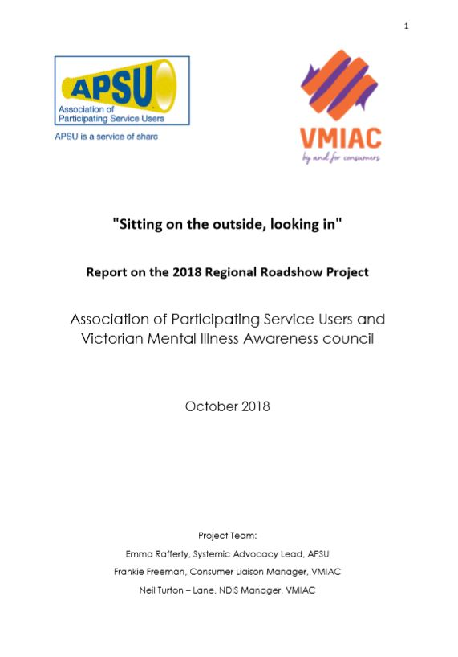
Regional Roadshow Report
The report “Sitting on the outside looking in”, documents the project & findings.
It can be found on the APSU webpage www.apsuonline.org.au
under ‘resources’.

Slide 7


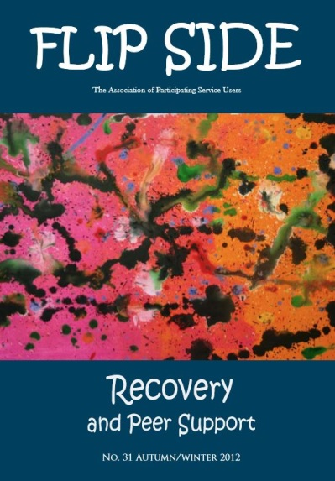




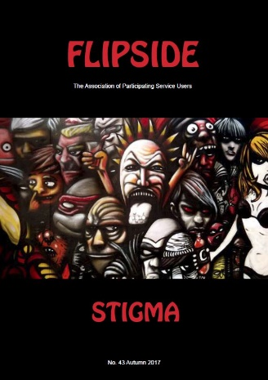







Flipside
Consumer stories on addiction and recovery related topics.
3 issues per year.

Slide 8
Flipside
“Our system classifies people into categories. This not only affects their standards of living, but it dictates their lifestyles too.” (n. 43 Stigma)
“People also don’t understand domestic violence and why you stay. You stay because you believe you deserve it.” (n. 45 Food)
“Still sitting in the same spot I was 6 months ago when I decided to “change my life” even after trying numerous times to get a job, ANY JOB!” (n. 38 Ice)
“Life didn’t stop when we used and start when we stopped.” (n. 35 Change)

Slide 9

Speakers Bureau
Database of trained speakers available to share their lived experience in a public forum
All SB members have been impacted by drug addiction either directly or through a family member / significant other, but have a variety of different experiences
Service available for community and professional events for a fee
Training delivered 2-3 times per year, due to interest and speaker turnover

Slide 10

Speakers Bureau
Goals: educate audiences about addiction and recovery, challenge stigma, provide hope
Context driven, suitable to different audiences
Well formulated and thought through requests lead to more successful presentations

Slide 11
Speakers Bureau
Overwhelmingly positive feedback:
  “He is so real, coming from the heart as well as valuing the truth very highly.“
  “From the comments made in the evaluation, it was without a doubt the most well received part of the training and received 100% positive feedback.”
  “It was a successful event and our students were certainly engaged. The presenters were outstanding and pulled no punches.”
  “The group were ‘blown away” by her honesty, courage and determination. They were just amazed at how well she spoke, complimenting her on her obvious intelligence and sensitivity. They said they found the session soooooo helpful and she gave them such hope for their own families.”

Slide 12


‘Straight from the Source’- APSU Podcast
Increase the impact & visibility of consumer stories
Increase education and awareness
Discuss issues with the Australian AOD system
Help people to feel represented and less alone
Cover distinctive stories which challenge stigma, stereotypes & binary ideas
Challenge the idea of one dominant/ superior perspective on substance use or recovery
Look holistically at all of the life areas substance use intersects with

Slide 13
How can you use the Podcast?
Contribute your stories, listen and feel heard, share it around so these stories create the most impact they can
As a professional in the sector- use it to support your clients and their loved ones, to enhance practice, to open up new understandings, to keep informed on the issues consumers & sector professional are talking about, and as a platform to discuss the issues you want to talk about.

Slide 14


"I'm not just a person with addiction I'm all these other things like a belly dancer, a guitarist, a mum, a loud mouth , a bitch, I'm nice, I'm a daughter- I'm not just an addict and that’s all of us, we are all whole people.“
- Rustie, First Podcast Episode

Slide 15
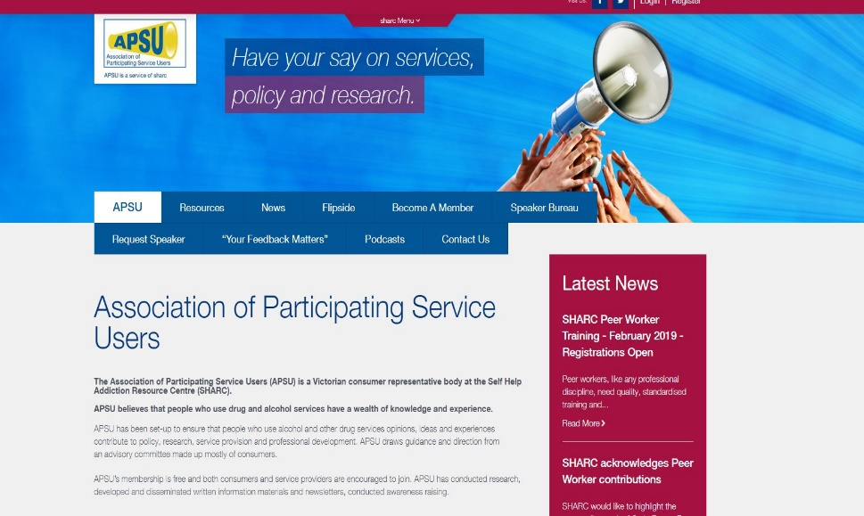
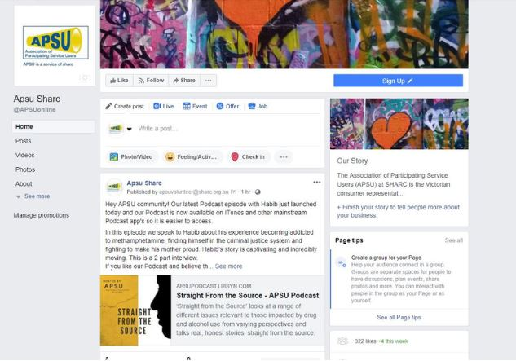
Where to find us?
APSU website: www.apsuonline.org.au
APSU Facebook: search Apsu Sharc or www.facebook.com/APSUonline/
Podcast Applications: ITunes, Spotify, Castbox, other Podcast app's search 'Straight from the Source- APSU Podcast‘
Email us: apsu@sharc.org.au

